Slide 1


BallotOnline’s Cloud Adoption Plan: Strategic, Scalable, Secure
Presentation by: Kareem Rizk

Slide 2
Executive Summary
BallotOnline has reached full capacity with its current on-premises infrastructure.
Global expansion requires a scalable and flexible infrastructure solution.
Cloud adoption is projected to reduce IT costs by approximately 60% annually, from $10.8M (IT annual budget) to $3.98M.
Cloud offers:
Faster response to business growth
Reduced operational complexity
Robust backup and disaster recovery options
Recommendation: Shift to a Cloud-First strategy to support scalability, agility, and long-term growth.

Slide 3

2. What is Cloud Computing?
2

Slide 4
On-demand access to computing resources (e.g., servers, storage, databases) over the internet
Based on a pay-as-you-go model — no need to buy physical hardware
Scalable, flexible, and managed by cloud providers
Defined by NIST as a model enabling convenient, on-demand network access to shared resources
3

Slide 5

3. Cloud vs. On-Premises – Key Advantages
4

Slide 6
Cloud Key Advantages
Scalability: Instantly scale resources up or down based on demand
Cost Efficiency: No upfront hardware costs; pay only for usage
High Availability: Built-in redundancy across global regions
Faster Deployment: New services and infrastructure in minutes
Managed Services: Automatic updates, patching, and maintenance
Disaster Recovery: Integrated backup and recovery capabilities
Remote Access: Secure access to resources from anywhere

Slide 7

4. Cloud Services and Deployment Models
6

Slide 8
Service Models:
Deployment Models:
IaaS (Infrastructure as a Service): Provides virtualized computing resources (e.g., AWS EC2, Azure VM)
PaaS (Platform as a Service): Development and deployment platforms (e.g., AWS Elastic Beanstalk)
SaaS (Software as a Service): Full applications delivered over the web (e.g., Gmail, Dropbox)
Public Cloud: Shared resources over the public internet (e.g., AWS, Azure)
Private Cloud: Dedicated infrastructure for one organization (e.g., VMware private cloud)
Hybrid Cloud: Mix of on-prem and cloud environments
In this presentation, we will use AWS as a representative model for cloud infrastructure.

Slide 9
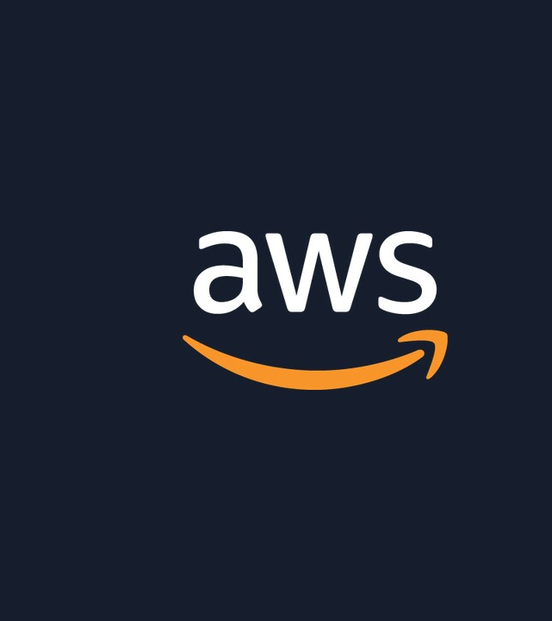
5. Cloud Computing and Storage Infrastructure Components (AWS as a model)

Slide 10
Service Models:
Amazon S3: Object storage for unstructured data
Amazon RDS: Managed relational databases
Amazon VPC: Isolated network environments within AWS
Amazon EBS: Block storage volumes for EC2 instances
Elastic Load Balancer: Distributes traffic across instances
Amazon CloudFront: Global content delivery network

Slide 11
Cloud Computeing VS On-Premises
AWS Cloud Service | ≡ | On-Premises Equivalent
Amazon EC2 | ≡ | Physical Servers / Virtual Machines
Amazon S3 | ≡ | File Servers / NAS
Amazon RDS | ≡ | Locally Managed Relational Databases
Amazon VPC | ≡ | Network Switches, Routers, VLANs
Amazon EBS | ≡ | RAID Storage / Local Disks
Elastic Load Balancer (ALB/NLB) | ≡ | Hardware Load Balancer (e.g., F5, Cisco)
Amazon CloudFront | ≡ | On-Premises Caching Servers / CDN Appliances

Slide 12
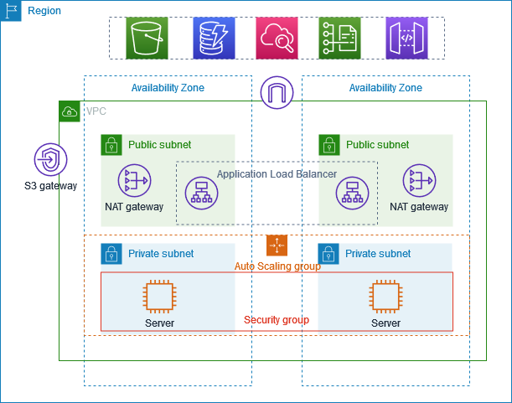
Classic AWS Architecture

Slide 13

6. Advantages and Disadvantages of Cloud Computing
Advantages:
12

Slide 14
Advantages | Disadvantages
Cost savings | Data security concerns
Scalability and elasticity | Compliance challenges
High availability | Vendor lock-in risks
Built-in disaster recovery | Downtime dependency
Minimal maintenance overhead | Limited control over low-level configurations
Global access | Cost monitoring required

Slide 15

7. Economic Analysis – Cloud vs. On-Premises
14

Slide 16
On-Premises Costs: | AWS Cloud Costs:
General Operating Expenses: $6M/year | EC2: ~$2.69M/year
Hardware depreciation: $800K/year | RDS: ~$1.13M/year
Support and operations: $6.8M/year | Storage & others: ~$160K/year
Total annual cost: ~$7.6M | Total annual cloud cost: ~$3.98M
Insight: The cloud model offers approximately 60% cost reduction, based on BallotOnline’s current $10 million annual IT budget, while enabling more flexible and scalable resource allocation.
All AWS Cloud cost estimates were calculated using the AWS Pricing Calculator**, based on BallotOnline's projected infrastructure needs and usage patterns.**
15

Slide 17
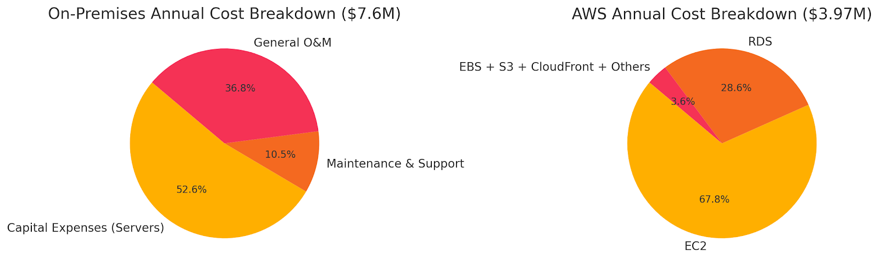
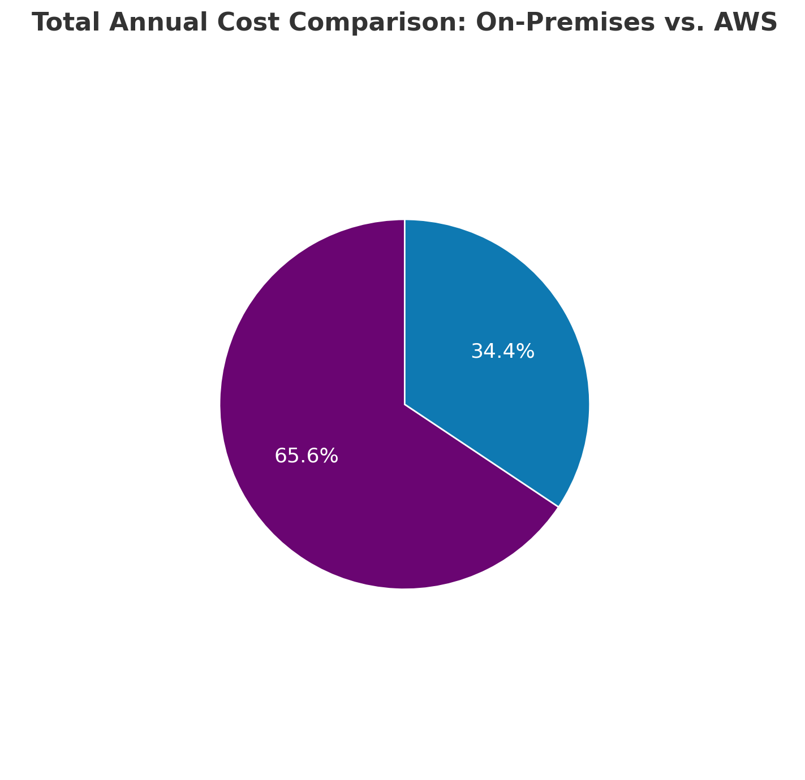
🟣 On-Premises: 65.6%
🔵 AWS Cloud: 34.4%
Compared to infrastructure costs only ($7.6M): The estimated savings are approximately 48% when migrating to the cloud.
Compared to the total IT budget ($10M): The estimated savings increase to around 60%, reflecting a broader financial impact.
The cloud solution represents just 34% of what we currently spend.
16

Slide 18

8. IT Business Requirements
17

Slide 19
Functional Requirements: | Non-Functional Requirements:
Support for global access with multi-language options | 99.99% availability during elections
Auto-scaling during election traffic surges | Compliance with regulations (e.g., GDPR, FedRAMP)
Integration with existing SSO systems | Multi-region scalability
Real-time backup and recovery | Budget adherence (~$330K/month)
Secure remote access for all users | 24/7 monitoring and incident response

Slide 20

9. SWOT Analysis: Cloud Adoption for BallotOnline
Strengths
19

Slide 21
Cost savings (~60%)
High flexibility
Operational efficiency
Built-in disaster recovery
Vendor lock-in
Compliance complexity
Internet dependency
Training required
Strengths
Weaknesses
Expand into global markets
Utilize advanced services (AI, analytics)
Improve uptime and performance
Accelerate service delivery
Data breaches
Regulatory barriers
Cloud outages
Uncontrolled cost growth
Opportunities
Threats
20

Slide 22

Final Strategic Notes:
Leverage strengths to maximize opportunities
Address weaknesses via training and cloud governance
Mitigate threats with robust security and compliance tools
21

Slide 23

Thank you
Kareem Rizk
202-621-4174
Krizk1@student.umgc.edu
Kareem.magdy5@gmail.com

Slide 24
REFERENCES
National Institute of Standards and Technology (NIST). (2011). The NIST Definition of Cloud Computing (SP 800-145). https://nvlpubs.nist.gov/nistpubs/Legacy/SP/nistspecialpublication800-145.pdf
Amazon Web Services. (n.d.). AWS Pricing Calculator. https://calculator.aws.amazon.com/
Amazon Web Services. (n.d.). What is Amazon EC2? https://aws.amazon.com/ec2/
Amazon Web Services. (n.d.). Amazon RDS. https://aws.amazon.com/rds/
Amazon Web Services. (n.d.). Amazon S3. https://aws.amazon.com/s3/
Gartner. (2023). Magic Quadrant for Cloud Infrastructure and Platform Services. https://www.gartner.com/en/documents/4005995
University of Maryland Global Campus (UMGC). (2025). Project 1: Overview of Cloud Technology Guidelines. https://learn.umgc.edu
Anthes, G. (2010). Security in the Cloud. Communications of the ACM, 53(11), 16–18. https://doi.org/10.1145/1839676.1839683
AWS resources calculations.

